Slide 1

Chapter 8
Regression Testing
Objectives
Regression Testing is necessary to maintain software whenever there is update in it.
Regression testing increases quality of software.
Objectives of Regression testing
Types of Regression Testing
Regression Testability
Regression testing is a problem- definition of problem
Regression Testing techniques

Slide 2
Progressive vs. Regressive Testing
Selective retesting of a system or component to verify that modifications have not caused unintended effects and that the system or component still complies with its specified requirements.

Slide 3
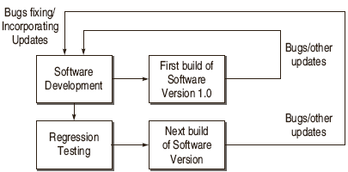
Evolution of Software Testing
Regression Testing produces Quality Software

Slide 4
Objectives of Regression Testing
Regression Tests to check that the bug has been addressed
Regression Tests to find other related bugs
Regression tests to check the effect on other parts of the program

Slide 5
When to do regression testing?
Software maintenance
Rapid iterative development
First step of integration
Compatibility assessment and benchmarking

Slide 6
Regression Testing Types
Bug-Fix Regression
Side-Effect Regression / Stability Regression

Slide 7
Regression Testing Problem
Given a program P, its modified version P’ and a test set T that was used to previously test P, find a way to utilize T to gain sufficient confidence in the correctness of P’.

Slide 8
Software Testing Myths
Regression Testing Techniques
Regression Test Selection Technique:
Test Case Prioritization Technique:
a) General Test Case Prioritization
b) Version Specific Test Case Prioritization:
Test Suite Reduction Technique

Slide 9
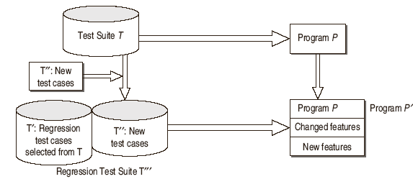
Selective Retest Technique

Slide 10
Regression Test Selection Techniques
Minimization Techniques
Dataflow Techniques
Safe Techniques
Adhoc / Random Techniques
Retest-all Technique

